Slide 1

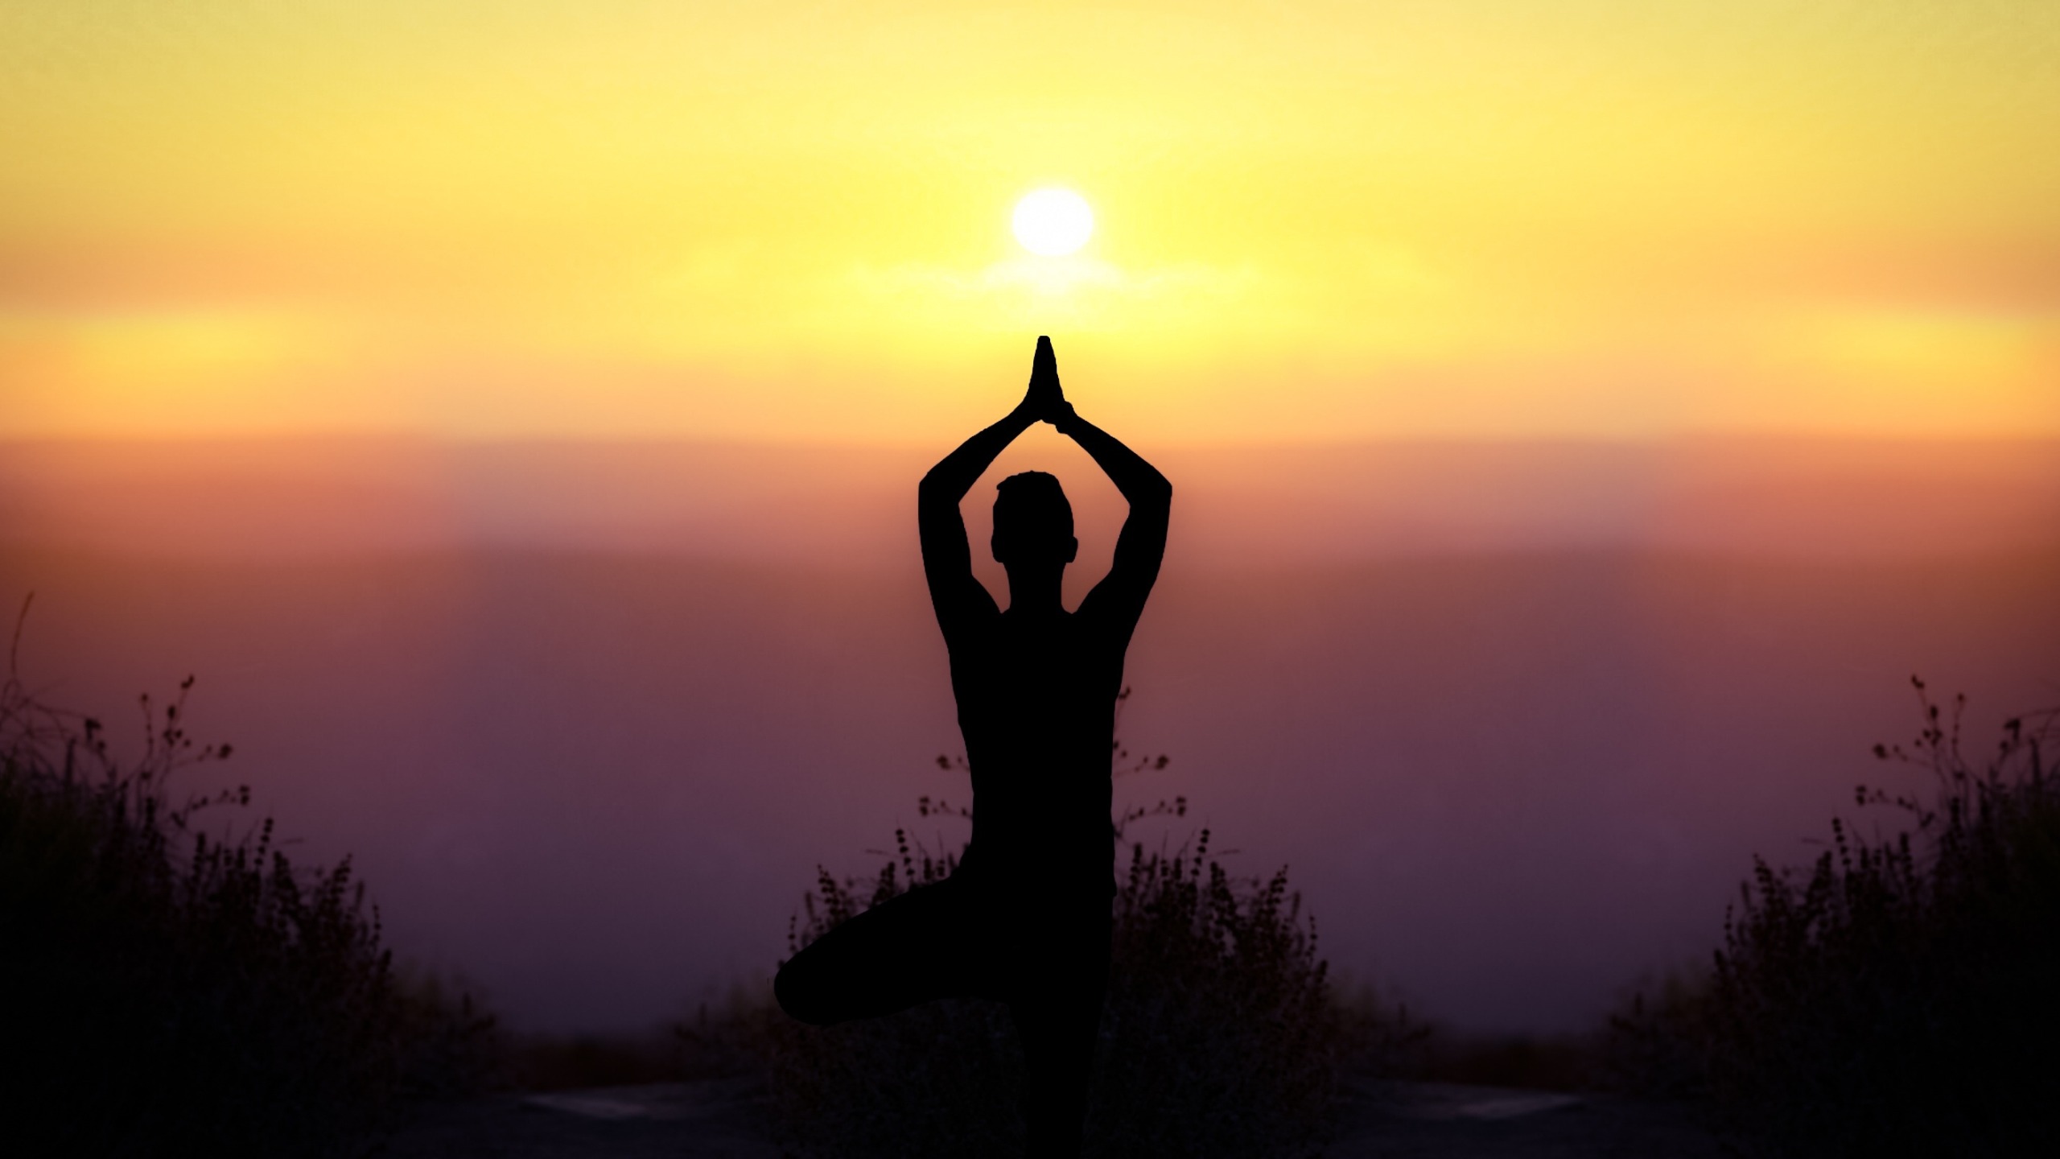
YOGA: ITS ORIGIN, HISTORY & DEVELOPMENT
1.2

Slide 2
1. ORIGIN, History
Starting from 2700 B.C. Mythologically, Lord Shiva was the 1st teacher of Yoga.
HISTORY:
PRE VEDIC PERIOD (2700 BC):Yoga was defined as Immortal cultural outcome during the Indus valley civilization.
Sun was given importance, hence Suryanamaskar came into picture. There was no written scriptures about yogic philosophy.
VEDIC PERIOD (1500 BC): Vedas and its philosophy was introduced.
PRE CLASSICAL PERIOD: Jnyana Yoga and Karma Yoga was introduced. Vedic Literature was explained in Upanishads.

Slide 3
1. ORIGIN, History
CLASSICAL PERIOD (500 BC- 800 AD): Vyasa Rishi came into exitance and he introduced different paths of yoga (Jnyana Yoga, Karma Yoga, Bhakti yoga & Raja yoga). Sage Patanjali introduced Raja yoga and he is said to be the Father of Yoga, founder of Yogic philosophy (Introduced yoga sutras, Ashtanga yoga etc.)
Buddhism was introduced, Importance of breathing was introduced.
POST CLASSICAL PERIOD (800 AD – 1700 AD) : Teachings of great Yogacharyas: Shankaracharya, Ramanujacharya etc.. Physical body, asanas were given importance. Tantra Yoga was introduced.
MODERN PERIOD (1700 AD – 1900 AD): Swami Vivekananda and Shri Ramakrishna Paramahansa introduced yogic philosophy and provided different scriptures explaining the importance of living a yogic lifestyle. Hatha Yoga and Mantra yoga was also introduced.

Slide 4
Development
In modern era, Yoga was given major importance. Traditional schools introduced yoga and this is how the yogic knowledge was spread.
All these paths of yoga, which we are learning has one aim of yoga which is to achieve a state of self realization for a peace of mind.

